Slide 1
ITP - Chapter 4
西南林业大学
Trade Terms
Page 52-71

Slide 2
Clearing the Ground
(What is a trade term?)
A trade term is a three-letter acronym that allocates the cost, risk of loss and responsibilities of transporting the goods between the seller and the buyer. (the INCOTERMS 2000)

Slide 3
Clearing the Ground
(What is a Incoterms?)
The Incoterms or International Commercial Terms are a series of pre-defined commercial terms published by the International Chamber of Commerce (ICC) relating to international commercial law. They are widely used in international commercial transactions or procurement processes and their use is encouraged by trade councils, courts and international lawyers. The latest version is INCOTERMS 2010.

Slide 4
Section 1. Trade Terms and the Sales Contract
USD 100 per dozen CIF NEW YORK
The unite price of a commodity is made up of (1) a name of currency, (2) price per unit, (3) measuring unit, (4) trade term, and (5) a name of destination or shipping place.

Slide 5
Section 1. Trade Terms and the Sales Contract
The Danger of Modifying Trade Terms
It is important to use the trade term without further explanation and to make sure that other terms in the contract do not expressly conflict with the term chose.
In practice, it frequently happens that the parties themselves by adding words to an Incoterm seek further precision than the term could offer.

Slide 6
Section 1. Trade Terms and the Sales Contract
The Danger of Modifying Trade Terms
For instance, “FOB stowed”, Incoterms give no guidance whatsoever for such additions. So the parties are strongly advised to clarify intentions.
If the parties insert additional terms, the dangers of varying the standard trade terms are illustrated in the case of 4-2.

Slide 7
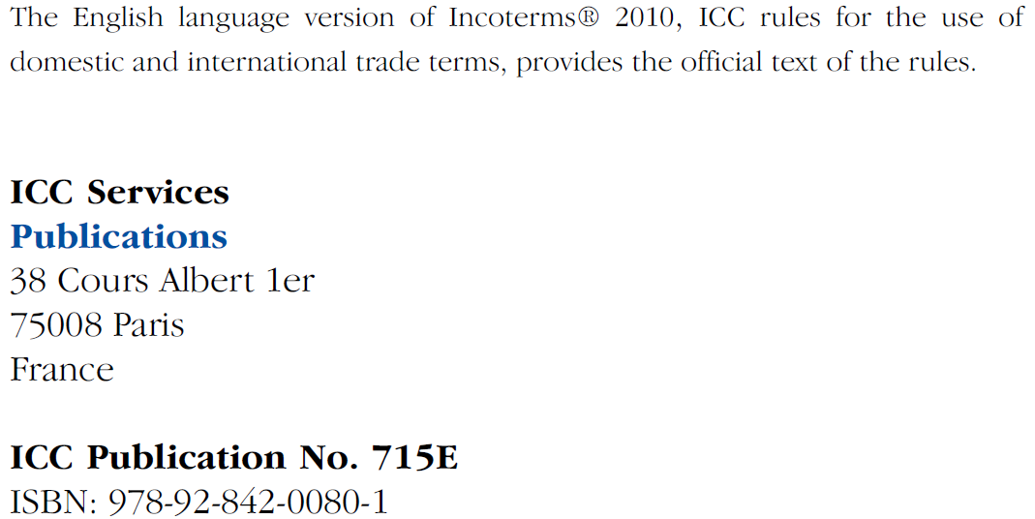
Section 2 Incoterms 2010 Summary

Slide 8
Section 2 Incoterms 2010 Summary
1. Terms Replacement
Two new Incoterms rules – DAT and DAP – have replaced the Incoterms 2000 rules DAF, DES, DEQ and DDU

Slide 9
Section 2 Incoterms 2010 Summary
1. Terms Replacement
The number of Incoterms rules has been reduced from 13 to 11. This has been achieved by substituting two new rules that may be used irrespective of the agreed mode of transport – DAT, Delivered at Terminal, and DAP, Delivered at Place – for the Incoterms 2000 rules DAF, DES, DEQ and DDU.

Slide 10
Section 2 Incoterms 2010 Summary
1. Terms Replacement
Under both new rules, delivery occurs at a named destination: in DAT, at the buyer’s disposal unloaded from the arriving vehicle (as under the former DEQ rule); in DAP, likewise at the buyer’s disposal, but ready for unloading (as under the former DAF, DES and DDU rules).

Slide 11
Section 2 Incoterms 2010 Summary
1. Terms Replacement
The new rules make the Incoterms 2000 rules DES and DEQ superfluous. The named terminal in DAT may well be in a port, and DAT can therefore safely be used in cases where the Incoterms 2000 rule DEQ once was. Likewise, the arriving “vehicle” under DAP may well be a ship and the named place of destination may well be a port: consequently, DAP can safely be used in cases where the Incoterms 2000 rule DES once was. These new rules, like their predecessors, are “delivered”, with the seller bearing all the costs (other than those related to import clearance, where applicable) and risks involved in bringing the goods to the named place of destination.

Slide 12
Section 2 Incoterms 2010 Summary
2. Classification
The 11 Incoterms® 2010 rules are presented in two distinct classes
(1) RULES FOR ANY MODE OR MODES OF TRANSPORT
(2) RULES FOR SEA AND INLAND WATERWAY TRANSPORT

Slide 13
Section 2 Incoterms 2010 Summary
2. Classification

Slide 14
Section 2 Incoterms 2010 Summary
2. Classification
(1) RULES FOR ANY MODE OR MODES OF TRANSPORT
The first class includes the seven Incoterms® 2010 rules that can be used irrespective of the mode of transport selected and irrespective of whether one or more than one mode of transport is employed. EXW, FCA, CPT, CIP, DAT, DAP and DDP belong to this class. They can be used even when there is no maritime transport at all. It is important to remember, however, that these rules can be used in cases where a ship is used for part of the carriage.

Slide 15
Section 2 Incoterms 2010 Summary
2. Classification
(2) RULES FOR SEA AND INLAND WATERWAY TRANSPORT
In the second class, the point of delivery and the place to which the goods are carried to the buyer are both ports, hence the label “sea and inland waterway” rules. FAS, FOB, CFR and CIF belong to this class. Under the last three Incoterms rules, all mention of the ship’s rail as the point of delivery has been omitted in preference for the goods being delivered when they are “on board” the vessel. This more closely reflects modern commercial reality and avoids the rather dated image of the risk swinging to and fro across an imaginary perpendicular line.

Slide 16
Section 2 Incoterms 2010 Summary
3. Rules for domestic and international trade
Incoterms rules have traditionally been used in international sale contracts where goods pass across national borders. In various areas of the world, however, trade blocs, like the European Union, have made border formalities between different countries less significant. Consequently, the subtitle of the Incoterms® 2010 rules formally recognizes that they are available for application to both international and domestic sale contracts. As a result, the Incoterms® 2010 rules clearly state in a number of places that the obligation to comply with export/import formalities exists only where applicable.

Slide 17
Section 2 Incoterms 2010 Summary
3. Rules for domestic and international trade
Two developments have persuaded ICC that a movement in this direction is timely.
Firstly, traders commonly use Incoterms rules for purely domestic sale contracts.
The second reason is the greater willingness in the United States to use Incoterms rules in domestic trade rather than the former Uniform Commercial Code shipment and delivery terms.

Slide 18
Section 2 Incoterms 2010 Summary
4. Electronic communication
Previous versions of Incoterms rules have specified those documents that could be replaced by EDI messages. Articles A1/B1 of the Incoterms® 2010 rules, however, now give electronic means of communication the same effect as paper communication, as long as the parties so agree or where customary. This formulation facilitates the evolution of new electronic procedures throughout the lifetime of the Incoterms® 2010 rules.

Slide 19
Section 2 Incoterms 2010 Summary
5. Insurance cover
The Incoterms® 2010 rules are the first version of the Incoterms rules since the revision of the Institute Cargo Clauses and take account of alterations made to those clauses. The Incoterms® 2010 rules place information duties relating to insurance in articles A3/B3, which deal with contracts of carriage and insurance. These provisions have been moved from the more generic articles found in articles A10/B10 of the Incoterms 2000 rules. The language in articles A3/B3 relating to insurance has also been altered with a view to clarifying the parties’ obligations in this regard.

Slide 20
Section 2 Incoterms 2010 Summary
6. String sales
In the sale of commodities, as opposed to the sale of manufactured goods, cargo is frequently sold several times during transit “down a string”. When this happens, a seller in the middle of the string does not “ship” the goods because these have already been shipped by the first seller in the string. The seller in the middle of the string therefore performs its obligations towards its buyer not by shipping the goods, but by “procuring” goods that have been shipped. For clarification purposes, Incoterms® 2010 rules include the obligation to “procure goods shipped” as an alternative to the obligation to ship goods in the relevant Incoterms rules.

Slide 21
Section 2 Incoterms 2010 Summary
7. DAT
Delivered at Terminal
DAT (insert named terminal at port or place of destination)

Slide 22
Section 2 Incoterms 2010 Summary
7. DAT
This rule may be used irrespective of the mode of transport selected and may also be used where more than one mode of transport is employed.

Slide 23
Section 2 Incoterms 2010 Summary
7. DAT
“Delivered at Terminal” means that the seller delivers when the goods, once unloaded from the arriving means of transport, are placed at the disposal of the buyer at a named terminal at the named port or place of destination. “Terminal” includes any place, whether covered or not, such as a quay, warehouse, container yard or road, rail or air cargo terminal. The seller bears all risks involved in bringing the goods to and unloading them at the terminal at the named port or place of destination.

Slide 24
Section 2 Incoterms 2010 Summary
7. DAT
The parties are well advised to specify as clearly as possible the terminal and, if possible, a specific point within the terminal at the agreed port or place of destination, as the risks to that point are for the account of the seller. The seller is advised to procure a contract of carriage that matches this choice precisely.

Slide 25
Section 2 Incoterms 2010 Summary
7. DAT
Moreover, if the parties intend the seller to bear the risks and costs involved in transporting and handling the goods from the terminal to another place, then the DAP or DDP rules should be used.

Slide 26
Section 2 Incoterms 2010 Summary
7. DAT
DAT requires the seller to clear the goods for export, where applicable. However, the seller has no obligation to clear the goods for import, pay any import duty or carry out any import customs formalities.

Slide 27
Section 2 Incoterms 2010 Summary
8. DAP
Delivered at Place
DAP (insert named place of destination)

Slide 28
Section 2 Incoterms 2010 Summary
8. DAP
This rule may be used irrespective of the mode of transport selected and may also be used where more than one mode of transport is employed.

Slide 29
Section 2 Incoterms 2010 Summary
8. DAP
“Delivered at Place” means that the seller delivers when the goods are placed at the disposal of the buyer on the arriving means of transport ready for unloading at the named place of destination. The seller bears all risks involved in bringing the goods to the named place.

Slide 30
Section 2 Incoterms 2010 Summary
8. DAP
The parties are well advised to specify as clearly as possible the point within the agreed place of destination, as the risks to that point are for the account of the seller. The seller is advised to procure contracts of carriage that match this choice precisely. If the seller incurs costs under its contract of carriage related to unloading at the place of destination, the seller is not entitled to recover such costs from the buyer unless otherwise agreed between the parties.

Slide 31
Section 2 Incoterms 2010 Summary
8. DAP
DAP requires the seller to clear the goods for export, where applicable. However, the seller has no obligation to clear the goods for import, pay any import duty or carry out any import customs formalities. If the parties wish the seller to clear the goods for import, pay any import duty and carry out any import customs formalities, the DDP term should be used.

Slide 32
Section 2 Incoterms 2010 Summary
9. The whole picture of Incoterms 2010

Slide 34
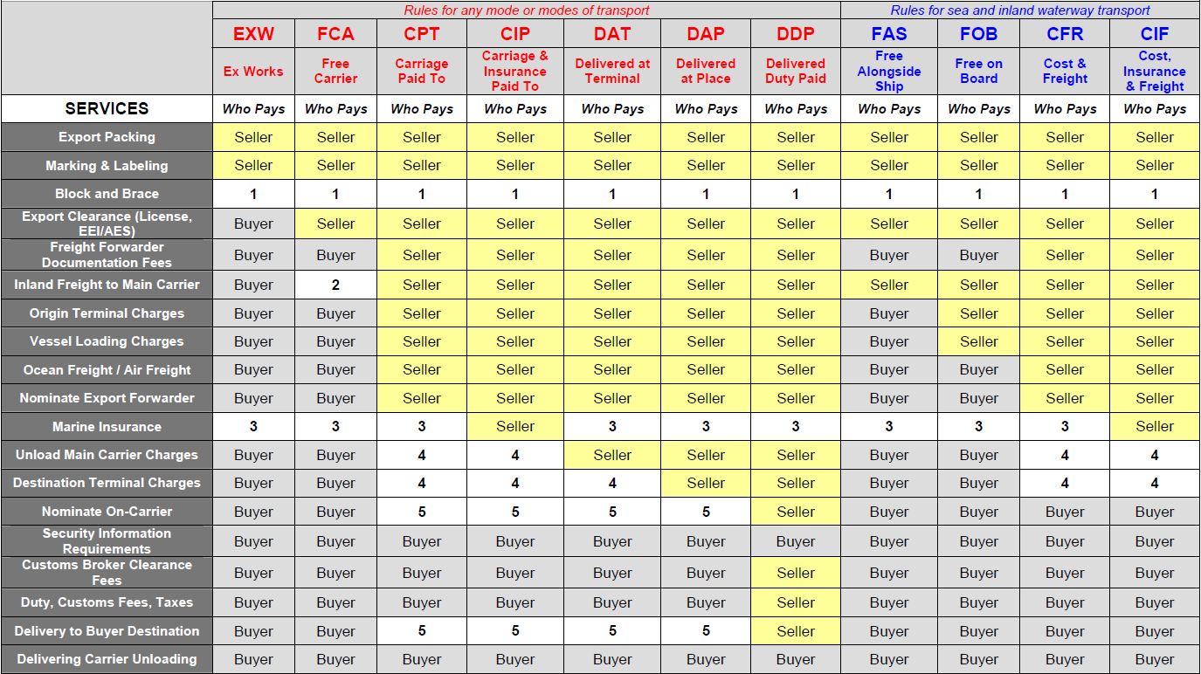
Section 2 Incoterms 2010 Summary

Slide 35
Section 2 Incoterms 2010 Summary
9. The whole picture of Incoterms 2010
Notes:
1 – Incoterms® 2010 do not deal with the parties’ obligations for stowage within a container and therefore, where relevant, the parties should deal with this in the sales contract.
2 – FCA Seller’s Facility – Buyer pays inland freight; other FCA qualifiers. Seller arranges and loads pre-carriage carrier and pays inland freight to the “F” delivery place

Slide 36
Section 2 Incoterms 2010 Summary
9. The whole picture of Incoterms 2010
Notes:
3 – Incoterms® 2010 does not obligate the buyer nor must the seller to insure the goods, therefore this issue be addressed elsewhere in the sales contract.
4 – Charges paid by Buyer or Seller depending on contract of carriage.
5 – Charges paid by Seller if through Bill of Lading or door-to-door rate to Buyer’s destination

Slide 37
Section 3 Export Costing and Quoting
1. Export Cost
Function:
Export costing calculations are used to assist exporters in ascertaining how competitive the company’s products will be in the target market once all the additional charges and fees have been taken into consideration.
The more responsibility assumed, the higher the price is.

Slide 38
Section 3 Export Costing and Quoting
2. Quoting
The purpose of a quotation is to provide the prospective buyer with detailed information of the company’s product, its costs and the terms of delivery.
(verbal, written, postal, electronic and faxed quotations)

Slide 39
Section 3 Export Costing and Quoting
3. Pro forma Invoice
It is a document issued as a temporary statement, which is binding neither on the importer nor the exporter. It is like an ordinary commercial invoice containing the general particulars, for example, marks, number of goods, descriptions, quantities, quality, price, etc.

Slide 40
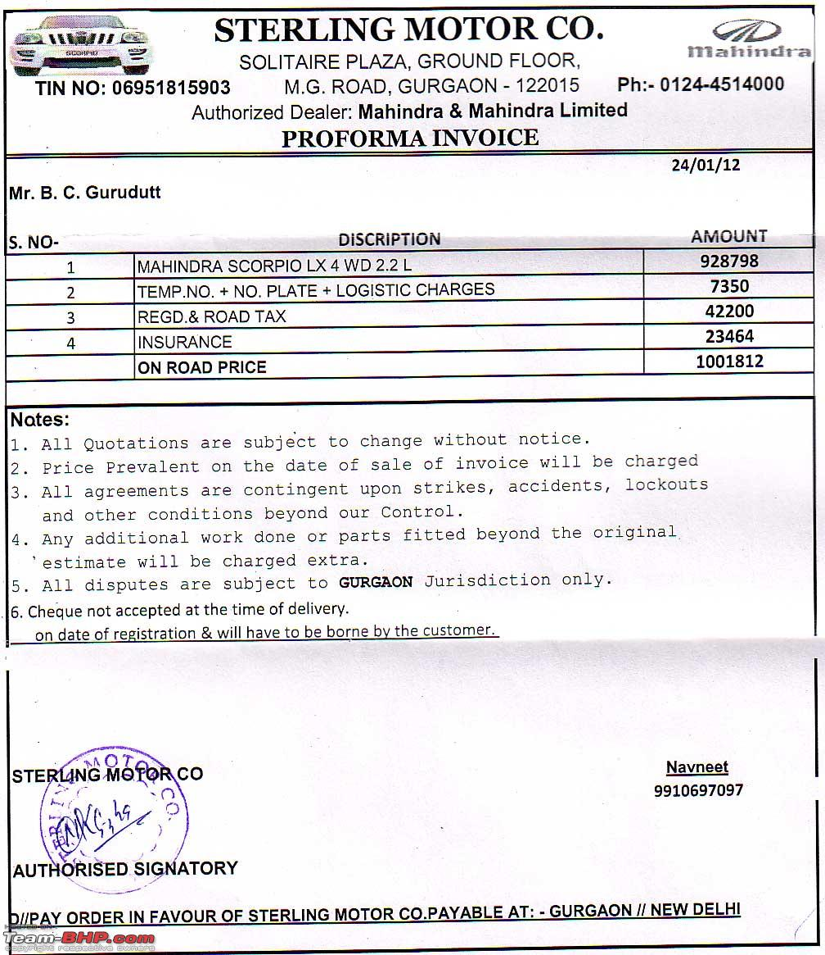
Pro Forma Invoice Sample

Slide 41
The End
Thanks!

