Slide 1
ITP - Chapter 5
西南林业大学
Quality Quantity and Packing of Commodity
Page 72-85

Slide 2
Clearing the Ground
(What is the chapter mainly about?)
This chapter mainly deals with the matters of quality, quantity and packing of the commodity.

Slide 3
Clearing the Ground
Reference:
《国际贸易实务》（第六版）对外经济贸易大学出版社，2017年1月
Page 53-67

Slide 4
Section 1 - Name of Commodity
The importance of the correct commodity name
The name of commodities should be concrete and specific.
If the goods delivered are not in accordance with the name in the contract, the buyer has the right to lodge a claim against the seller for compensation, reject the goods or even recede from his commitment (refer to Case 6-5).

Slide 5
Section 2 - Quality of Commodity
1. What is commodity quality?
The quality of commodities refers to the intrinsic attribute and the outer form or shape of the goods, such as modeling, structure, color, luster, taste, chemical composition, mechanical performance, biological features, etc.

Slide 6
Section 2 - Quality of Commodity
2. Ways to indicate the quality of the commodity
In international trade, there are two ways to indicate the quality of the goods, either (1) by description of (2) by sample.

Slide 7
Section 2 - Quality of Commodity
2. Ways to indicate the quality of the commodity
Sale by Description | By Specification, Grade or Standard
 | By Brand Name or Trademark
 | By Name of Origin
 | By Description and Illustration
Sale by Sample | By Seller’s Sample
 | By Buyer’s Sample

Slide 8
Section 2 - Quality of Commodity
1. Sales by Description
In International trade, most of the goods are sold by the method of sale by specification, grade or standard except some special cases.

Slide 9
Section 2 - Quality of Commodity
1. Sales by Description
Sale by Specification, Grade or Standard
The specification of the goods refers to certain main indicators which indicate the quality of the goods, such as composition, content, purity, size, length.

Slide 10
Section 2 - Quality of Commodity
1. Sales by Description
Sale by Specification, Grade or Standard
The grade of the goods refers to the classification of the commodity of one kind which is indicated by words, numbers or symbols.

Slide 11
Section 2 - Quality of Commodity
1. Sales by Description
Sale by Specification, Grade or Standard
The standard refers to the specifications or grades which are stipulated and announced (laid down and proclaimed) in a unified way by the government department or commercial organization of a country such as the chamber of commerce.

Slide 12
Section 2 - Quality of Commodity
1. Sales by Description
Sale by Specification, Grade or Standard - FAQ
In the international agricultural and by-product market, there is a commonly adopted standard, i.e. fair average quality (FAQ). FAQ refers to the average quality level of the export commodity within a certain period of time.

Slide 13
Section 2 - Quality of Commodity
1. Sales by Description
Sale by Specification, Grade or Standard - FAQ
The selling and buying of produce on a Fair Average Quality (FAQ) basis, as practiced by many national and international marketing agencies, is essentially subjective.

Slide 14
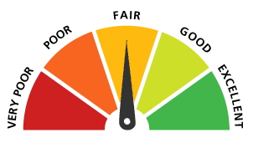
Section 2 - Quality of Commodity
1. Sales by Description
Sale by Specification, Grade or Standard - FAQ
If consecutive FAQ same from the same crop, or FAQ samples from the same growing area in consecutive years, or FAQ samples of the same commodity grown concurrently in different areas are compared objectively significant differences in quality may be revealed. Thus FAQ has a loose definition, and can only be applied when fairly wide variations in quality can be tolerated.

Slide 15
Section 2 - Quality of Commodity
1. Sales by Description
Sale by Specification, Grade or Standard - GMQ
For the trading of wood and aquatic products, good merchantable quality (GMQ) is employed to indicate the quality. GMQ means the goods are free from defects and are good enough for use or consumption.

Slide 16
Section 2 - Quality of Commodity
1. Sales by Description
Sale by Brand Name or Trademark
Brand is the name of the goods, while trademark is the tag. They are related to each other closely.

Slide 17
Section 2 - Quality of Commodity
1. Sales by Description
Sale by Name of Origin
Some goods are well known by their origins for their excellent qualities all over the world. As to these products, the origins may well indicate their qualities. These goods can be sold by name of origin, for example, Longjing Green Tea.

Slide 18
Section 2 - Quality of Commodity
1. Sales by Description
Sale by Description and Illustration
The specific descriptions of products are required to indicate the qualities of the goods, such as large-sized machines. If necessary, pictures and photos, must also be provided.

Slide 19
Section 2 - Quality of Commodity
2. Sales by Sample
In merchandising, a sample is a small piece or part of a product, often taken out from a whole lot or specially designed and processed. Arts and crafts, garments, light industry products, agricultural and native produce are generally sold by sample.

Slide 20
Section 2 - Quality of Commodity
2. Sales by Sample
Sale by Seller’s Sample
In practice, representative samples, or called original samples or type samples, are usually sent by the seller to the buyer, and at the same time, duplicate samples or keep samples are always kept but the seller for later reference. When the sample is accepted by the buyer, the seller is responsible for the delivery of the goods of the same quality as shown in the sample.

Slide 21
Section 2 - Quality of Commodity
2. Sales by Sample
Sale by Buyer’s Sample
Sale by buyer[s sample in China is also called processing according to the buyer’s samples.
If the buyer finds it hard to manufacture according to the sample, he may send a return or counter sample of similar quality to the buyer for his acceptance. The sale thus concluded is a sale by seller’s sample. For quality disputes, please refer to Case 4-3 or 4-4.

Slide 22
Section 2 - Quality of Commodity
3. Quality Clause
The quality clause in a sales contract is subject to the method used in describing the subject-matter of the contract.

Slide 23
Section 2 - Quality of Commodity
3. Quality Clause
Quality Tolerance
The quality tolerance refers to the quality deviation internationally recognized. It is advisable to make a specific mention of the quality tolerance in the contract, if necessary.

Slide 24
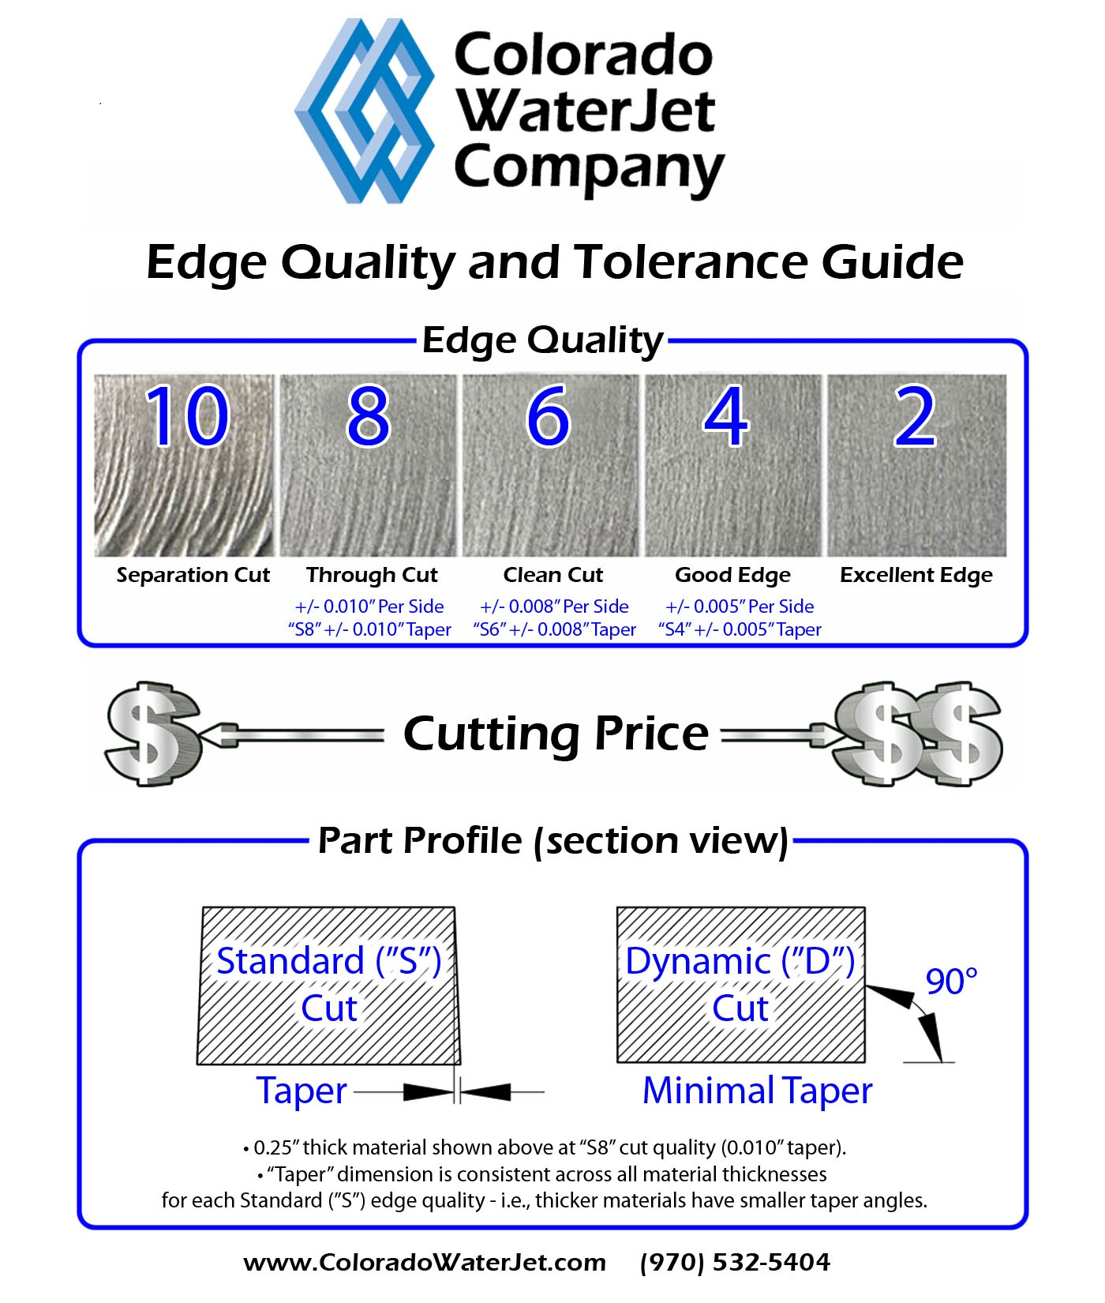
Section 2 - Quality of Commodity
3. Quality Clause
Quality Tolerance

Slide 25
Section 2 - Quality of Commodity
3. Quality Clause
ISO 9000
The ISO-9000 Series of Standards evolved by the International Standard Organization has been accepted worldwide as the norm assuring high quality of goods. The ISO-9000 is also the hallmark of a quality-oriented system for suppliers and manufacturers.

Slide 26
Section 2 - Quality of Commodity
3. Quality Clause
CQC & CCC (China Compulsory Certificate)
China Quality Certification Centre (CQC) is a professional certification body under China Certification & Inspection Group (CCIC) approved by State General Administration for Quality Supervision and Inspection and Quarantine and Certification and Accreditation Administration of the People's Republic of China. As the largest professional certification body in China, CQC evolved from the former China Commission for Conformity Certification of Electrical Equipment established in 1985. In April 2002, CQC was established by merging 6 institutions under 5 ministries

Slide 27
Section 2 - Quality of Commodity
3. Quality Clause
CQC & CCC (China Compulsory Certificate)
In December 2001, the State General Administration of Quality Supervision, Inspection and Quarantine of the People's Republic of China issued the Regulations for Compulsory Product Certification. The Compulsory Product Certification System began to replace the original Quality License System for Commodity Inspection and Safety Certification System for Electrical Equipment.

Slide 28
Section 2 - Quality of Commodity
3. Quality Clause
CQC & CCC (China Compulsory Certificate)
The abbreviation of China Compulsory Product Certification is CCC or 3C. It is the statutory compulsory safety certification system and the basic approach to safeguard the consumers' rights and interests and protect the personal and property safety, which is adopted widely by international organizations.

Slide 29
Section 2 - Quality of Commodity
http://www.cqc.com.cn/www/chinese/

Slide 30
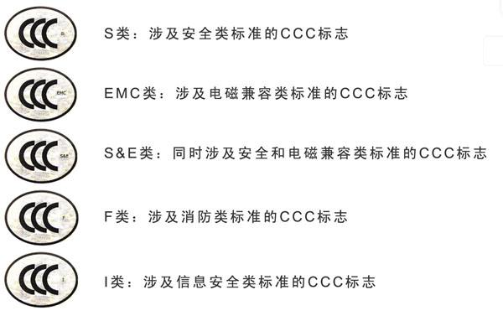
Section 2 - Quality of Commodity

Slide 31
Section 3 – Quantity of Commodity
At present, there are four metrologies commonly used in international trade:
(1) the metric system,
(2) the British System,
(3) the US System and
(4) the International System of Units (SI) （国际单位制）.

Slide 32
Section 3 – Quantity of Commodity
At present, there are four metrologies commonly used in international trade:
the metric system：
1889年第1届国际计量大会批准国际米原器（铂铱米尺）的长度为1米。1927年第7届计量大会又对米定义作了如下严格的规定：国际计量局保存的铂铱米尺上所刻两条中间刻线的轴线在 0℃时的距离（铂铱米尺是一根横截面近似为H形的尺子，在其中间横肋两端表面上各刻有3条与尺子纵向垂直的线纹，中间刻线是指每3条线纹的中间刻线）。这根尺子保存在1标准大气压下，放在对称地置于同一水平面上并相距571mm的两个直径至少为1cm的圆柱上。

Slide 33
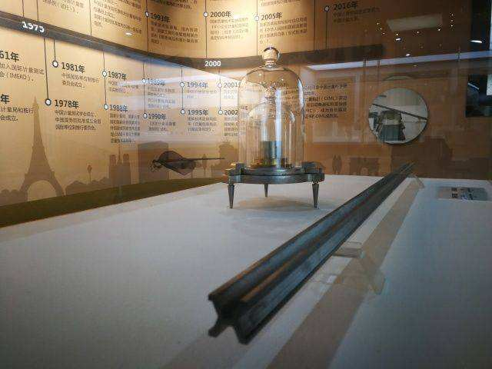
Section 3 – Quantity of Commodity
IPM or international prototype metre

Slide 34
Section 3 – Quantity of Commodity
At present, there are four metrologies commonly used in international trade:
the International System of Units (SI) ：
1960年第11届国际计量大会对米的定义更改如下：“米的长度等于氪－86原子的2p10和5d5能级之间跃迁的辐射在真空中波长的1650763.73倍。” 氪－86长度基准的极限不确定度为±4×10⁻⁹。

Slide 35
Section 3 – Quantity of Commodity
However, the metric system of SI units has been universally accepted and is being adopted in all countries.
China adopts the International System of Units (SI).

Slide 36
Section 3 – Quantity of Commodity
the International System of Units (SI).
The International System of Units (SI, abbreviated from the French Système international (d'unités)) is the modern form of the metric system, and is the most widely used system of measurement. It comprises a coherent system of units of measurement built on seven base units that are ampere, kelvin, second, metre, kilogram, candela, mole, and a set of twenty prefixes to the unit names and unit symbols that may be used when specifying multiples and fractions of the units.

Slide 37
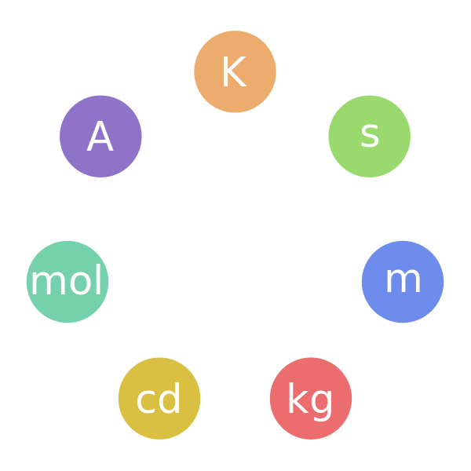
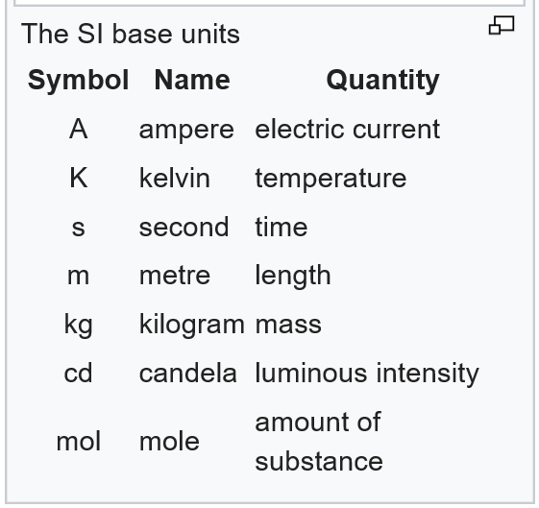
Section 3 – Quantity of Commodity
the International System of Units (SI).

Slide 38
Section 3 – Quantity of Commodity
1. Unit of Measurement
The unit of measurement applicable in international trade is variable as different systems on measures and weights are adopted by various countries.

Slide 39
Section 3 – Quantity of Commodity
2. Calculation of Weight
Weight can be calculated in gross weight, net weight, conditioned weight, theoretical weight and legal weight.
Gross weight = net weight + the tare weight

Slide 40
Section 3 – Quantity of Commodity
2. Calculation of Weight
Conditioned weight refers to the kind of weight derived from the process, with which the moisture content of the commodity is removed and standardized moisture added both by scientific methods. (refers to Rate of Official/Actual Moisture Regain, such as wool, raw silk, cotton, etc.)

Slide 41
Section 3 – Quantity of Commodity
2. Calculation of Weight
Theoretical weight
Commodities that have regular specifications and fixed regular size, are often subject to the use of theoretical weight.

Slide 42
Section 3 – Quantity of Commodity
2. Calculation of Weight
Legal weight
Legal weight is the weight of the goods and the immediate package of the goods. Such kind of goods include cans, small paper boxes, small bottles, etc.

Slide 43
Section 3 – Quantity of Commodity
3. More or Less Clause （溢短装条款）
Legal weight
“More or less” clauses are often used in the trading of agricultural or mineral products because it is difficult to weight them accurately. One alternative method is allowing, some percentage more or less of the quantity stipulated, i.e. the more or less clause (also called plus or minus clause).

Slide 44
Section 4 – Packing of Commodity
1. Functions of Packing
Preventing damage to a shipment
Offering the convenience that consumers often look for
Promoting a product by communicating its feature, uses, benefits, and image
Informing potential buyers about the product’s content, features, uses, advantages, and hazards

Slide 45
Section 4 – Packing of Commodity
2. Types of Packing
Many goods have little or no from of packing and are carried loose. They are nude cargo and cargo in bulk, such as iron and steel plates, oil, coal, etc.

Slide 46
Section 4 – Packing of Commodity
2. Types of Packing
Types of Packing | Functions
Transport packing | Protect the goods during transportation, easy to store and handle
Inner packing | Promote and protect the goods
Neutral packing | Break down customs barriers

Slide 47
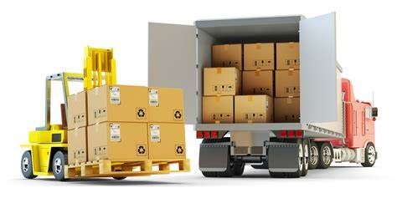
Section 4 – Packing of Commodity
2. Types of Packing

Slide 48
Section 4 – Packing of Commodity
2. Types of Packing

Slide 49
Section 4 – Packing of Commodity
2. Types of Packing
Neutral packing is the one that makes no mention of the name of the country producing the goods and the name of the manufacturer on the commodity and on the outer and inner package.

Slide 50
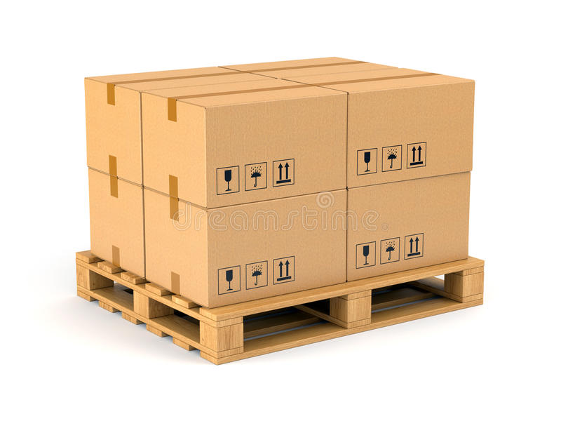
Section 4 – Packing of Commodity
pallet

Slide 51
Section 4 – Packing of Commodity
3. Labeling and Marking
Types of Marking | Functions
Shipping marks | Serve as an identification of the consignment to which they belong
Indicative marks | Facilitate handling
Warning marks | Warn dockers and crew against dangerous cargoes
Weigh/volume marks | Facilitate loading/unloading the goods or booking shipping space
Marks of origin | For customs statistics and taxation
Product code label | Standard bar code symbology for product marking

Slide 52
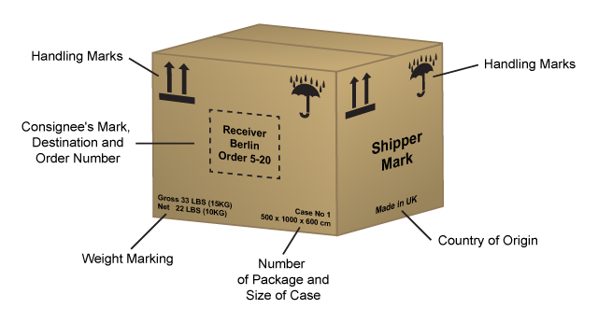
Section 4 – Packing of Commodity
3. Labeling and Marking

Slide 53
Section 4 – Packing of Commodity
3. Labeling and Marking
Fragile
Use No Hooks

Slide 54
Section 4 – Packing of Commodity
3. Labeling and Marking
Do Not Stack
This Way Up

Slide 55
Section 4 – Packing of Commodity
3. Labeling and Marking
Keep Dry
Temperature

Slide 56
Section 4 – Packing of Commodity
3. Labeling and Marking
Protect from Heat
Centre of Gravity

Slide 57
Section 4 – Packing of Commodity
3. Labeling and Marking
Handle with Care
Lift Box Here

Slide 58
Section 4 – Packing of Commodity
3. Labeling and Marking
Product Code & IANA
IANA = International Article Number Association
In 1991, China joined IANA which allocated numbers “690”, “691” and “692” to China, which means that any goods marked with these numbers are made in China.

Slide 59
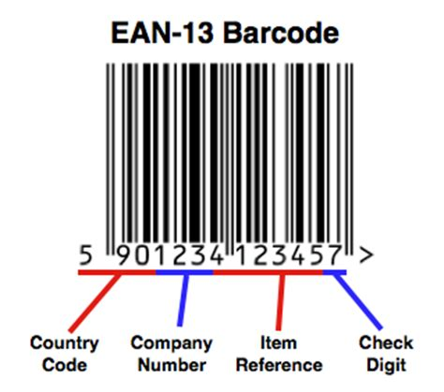
Section 4 – Packing of Commodity

Slide 60
The End
Thanks!

